Slide 1
Accounting Exam 1 Review
Overview and Practice Problems
Chapter 1 – 5, 11 + Appendix C

Slide 2
MEMORIZE
Working Capital Formulas
Retained Earnings = Net Income – Dividends
Assets = Liabilities + Equity
**Equations/explanations later in slide show

Slide 3
TA Tips
EXPECT TO HAVE A TIME CRUNCH
I am not saying that the test is undoable! However, most students will take the entire class period if not very close to the entire class period to finish the exam
Don’t spend too much time on one multiple choice question, think like ACT
SHOW YOUR WORK
There is partial credit for both the work out problem and the transactions
Show your logic/thought process

Slide 4
Chapter 1 Intro
4 Types of Businesses
General Benefits and Drawbacks for Each
Business Tax Structures

Slide 5
Business Tax Structures
Pass-Through Entities: Profits go to owners, who pay the taxes
Sole Proprietorship
Partnership
Limited Liability Companies (LLC)
S-Corporations
Corporate Taxpayers: Profits go to corporation, who pays taxes. Shareholders are also taxed on dividends, resulting in double taxes
C-Corporations

Slide 6
4 Types of Business + Drawbacks
Sole Proprietorship – One individual owning a business
Advantages: Low regulation, easy to form, and no corporate income taxes
Disadvantages: Limited lifespan, unlimited liability, hard to raise capital, no distinction in assets
Partnership– Multiple individuals owning a business
Advantages: Low regulation, easy to form, and no corporate income taxes
Disadvantages: Limited lifespan, unlimited liability, hard to raise capital, no distinction in assets
S-Corporation/LLC– Corporations that get taxed like partnerships/proprietorships
Advantages: Lifespan, limited liability protection, and no corporate income taxes
Disadvantages: Restrictions, harder to raise capital compared to C-corp
C-Corporation– Corporations, that exist as a separate legal entity
Advantages: Unlimited life, easy transfer, limited liability, ease of raising capital
Disadvantages: Double taxation, higher regulation, cost of set up and filing
Notes:
No distinction between private and business assets

Slide 7
Chapter 1/4
4 Financial Statements
Users of Financial Statements
Accounting Standards
SEC filings and certifications
Types of accounts/categories within each financial statement
Order of Balance Sheet
Asset v Expense
Retained Earnings Formula
Current versus Long Term (balance sheet)
Order of Income Statement
Audit Opinions
Categories of Ratio Analysis

Slide 8
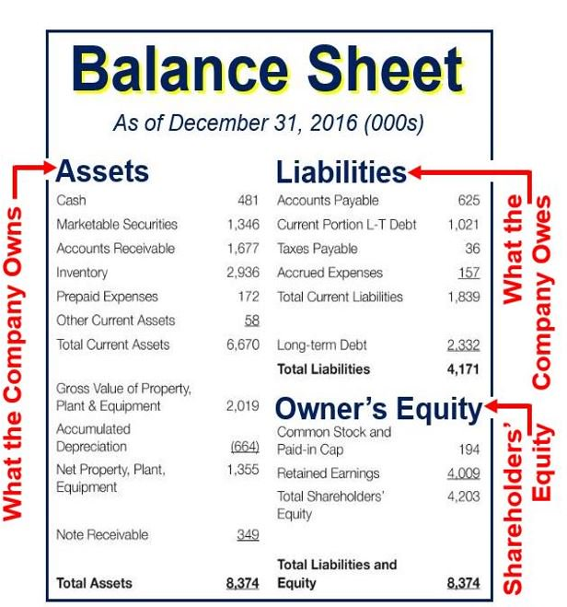
Balance Sheet
Reported at a Point in time
Assets = Liabilities + Equity
Current Assets, Non-Current Assets (In order of liquidity)
Current Liabilities, Non-Current Liabilities
Retained Earnings is last, before Total Equity

Slide 9
Current Versus long term (Balance Sheet)
General Rule of Thumb
Current Liabilities will be paid in the next year
Long Term Liabilities will be paid in more than a year
Current Assets
Quicker to convert to cash (Most liquid)
Cash, Short Term Investments, Accounts Receivables, Inventories, Prepaid Expenses
Long-Term Assets
Property, plant and Equipment (PPE), net, Long-term investments, Intangible and other assets

Slide 10
Market value vs book value or historical cost
Market Capitalization: A company’s Market Value
Multiply the number of outstanding common shares by the company’s stock price
Book Value: Stockholders’ Equity; Value of the company, determined by GAAP
Differences between Book and Market Value
GAAP generally reports assets and liabilities at historical costs, whereas the market attempts to estimate fair market values
GAAP excludes resources that cannot be reliably measured
GAAP does not consider market differences in which companies operate (competition and expected changes)
GAAP does not usually report expected future performance, where as that is what the market attempts to predict

Slide 11
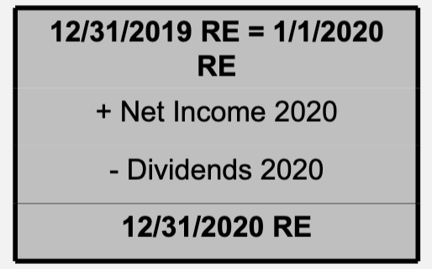
Retained earnings formula

Slide 12
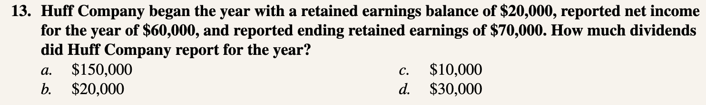
Chapter 1 P1-13

Slide 13
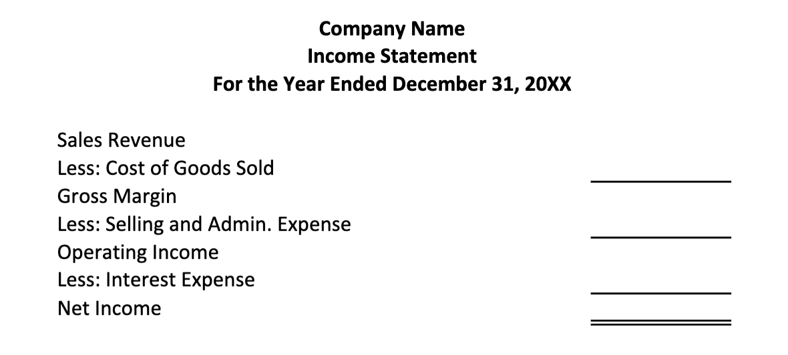
Income Statement
Reported over a period of time
More Generally:
Revenue
-Cost of Goods Sold
=Gross Profit
-Other Expenses
=Net Income

Slide 14
Requirements to be an asset
An object must be an ASSET if…
It is owned (or controlled) by the company
It confers expected future economic benefits that result from a past transaction or event

Slide 15
Asset versus expense
Understand: When a business spends money, it is not always immediately recorded as an expense on the income statement.
“How do we know if we should record spent money on the income statement?”
Does the purchase result in immediate benefit for the company?
Yes → Expense on the Income Statement
No, but it will result in future value → It is an asset, and not to be recorded on the income statement yet
When will we record the expense for the asset
When the asset has provided its benefit (it is used up!)
Depreciation Expense, COGS after inventory is sold

Slide 16
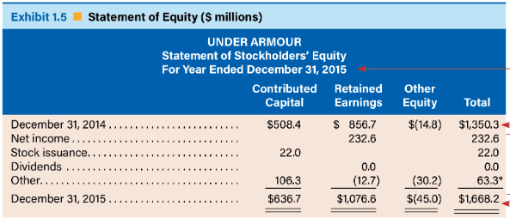
Statement of Stockholders’ equity
Reports Year-Over-Year Changes on the Equity Accounts
Remember to Total the Rows AND the columns
Net Income comes from Income Statement
Stock Issuance and Dividends will come from transactions to the Balance Sheet

Slide 17
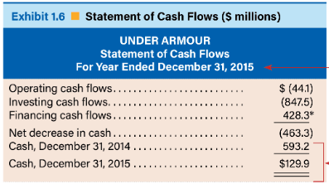
Statement of cash flows
Report changes to a company’s cash balance over a year’s time
Listed in the order of Operating, Investing, and Financing
Cash Balances should match the beginning balance and ending balance of the cash account on the balance sheet

Slide 18
Types of cash flow activities
Operating: Cash flows from the company’s transactions and events relating to operations
Includes tax paid and interest paid
Investing: Cash Flows from acquisitions, investments in marketable securities, and long-term assets
Financing: Cash Flows from issuances of stock and payments towards borrowings and equity
Issuances of Dividends are financing expenses (not recorded on the income statement)
Notes:
Add

Slide 19
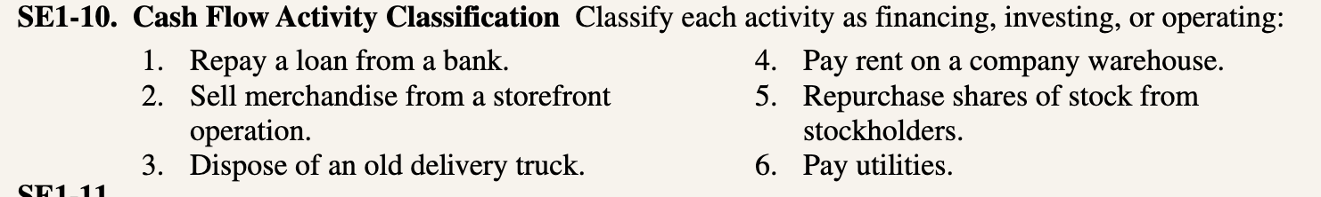
Chapter1 SE 1-10

Slide 20
types of accounts
How do we classify the following accounts?
Inventory
Cash
A loan to be repaid in ten years
A copy machine (Depreciation?) Money Spent on a copy machine?
Accounts Payable (Example?)
Accounts Receivable (Example?)
Notes:
Inventory – Asset (Current), balance sheet
Cash – Asset, balance sheet, income statement, cash flow
A loan to be repaid- Liability, balance sheet
Copy Machine- Asset, Depreciation – Negative asset. In Equipment on balance statement
Money Spent – Negative cash flow, investing expense
AP – Liability, BS
AR – Asset, BS

Slide 21
Notes on the Financial Statements
When you create them, do it in this order:
Income Statement, Balance Sheet, Statement of Stockholders’ Equity, Statement of Cash Flows
Places to check your work
(BS): Total Assets = Total Liabilities + Total Equity
Total Stockholders’ Equity (BS) = Total of all columns (SSE)
Cash Account Balances (BS) = Cash Balances (SCF)
It sounds obvious, but remember, if they are not equal across statements, you probably added incorrectly somewhere

Slide 22
users of financial statements
Managers and Employers
Investment Analysts and Information Intermediaries
Research Reports
Creditors and Suppliers
Need to know company’s current financial situation. Contributes to decisions on loaning goods or not
Stockholders and Directors
Also invested in company’s financial health. Helps drives stock prices, determine safety of investment

Slide 23
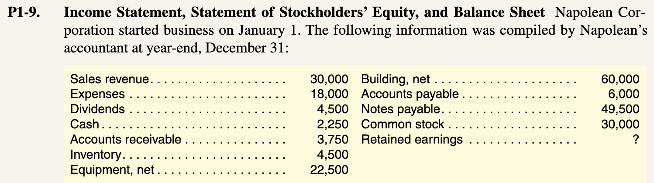
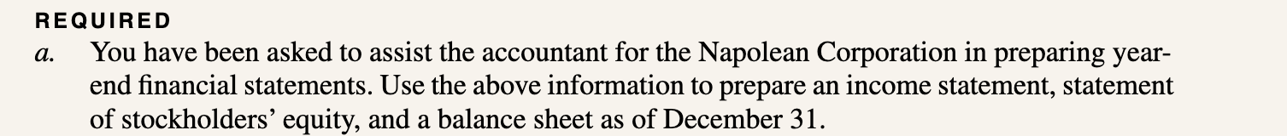
Chapter 1 p1-9

Slide 24
Accounting Standards and sec filings
The set of American Accounting Standards are called…
What are the benefits of having such standards?
Public Companies must publish unaudited quarterly reports with summary versions the four financial statements called…
Annually, they must publish audited versions of the entirety of the 4 financial statements with explanatory notes called…

Slide 25
Good Audit Opinion
The audit report is not a guarantee that no misstatements exist.
Auditors only provide reasonable assurance that the statements are free of material misstatements
Reasonable: not held to an absolute standard if problems are uncovered
Material: item must be of sufficient magnitude (such as a decision to purchase stock or extend credit)

Slide 26
Simple Ratio Analysis Categories
Liquidity: Ability for a company to pay its short-term obligations
Current Ratio: Current Assets/Current Liabilities
Solvency: Ability for a company to pay its long-term financial obligations
Debt to Assets: Debts/Assets
Profitability: Analysis of a company’s profit
Profit Margin: Net Income / Net Sales

Slide 27
Chapter 2
Accounting cycle steps
Permanent vs temporary accounts
Accounting terms: Account, element, financial statement line, general ledger, source document

Slide 28
accounting Key Terms
Account – a record of the increases and decreases in a specific asset, liability, or equity item
Element – One of the three elements of the accounting equation (assets, liabilities or equity)
Source Document – records that are generated when a firm engages in a business transaction
Chart of Accounts – all the account titles in a business’ accounting system
General Ledger – listing of each of a business’ accounts and amounts from all transactions recorded during a period

Slide 29
accounting cycle steps
STEP 1: Analyze transactions
Make sure that your transaction will balance on the balance sheet.
STEP 2: Record transactions in the accounting records
A transaction will impact the cash flow statement iff it impacts cash on the balance sheet
Any transaction that increases/decreases net income impacts retained earnings
Dividends impact retained earnings, but not the income statement
STEP 3: Adjust transactions. This will never impact cash.
STEP 4: Prepare Financial Statements (income Statement -> Balance Sheet -> Statement of Stockholders’ Equity -> Statement of Cash Flows)
STEP 5: Close the temporary accounts in anticipation of the start of a new accounting cycle

Slide 30
Permanent vs temporary accounts
Temporary Accounts
Balances are zero at the start of each accounting period
Income statement (revenues and expenses) and the dividend account
Permanent Account
Accounts carry over from period to period
Balance sheet

Slide 31
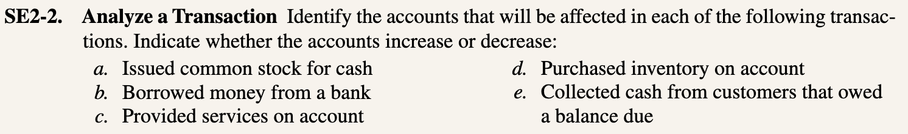
Chapter 2 SE2-2
Notes:
Keep but don’t go through

Slide 32
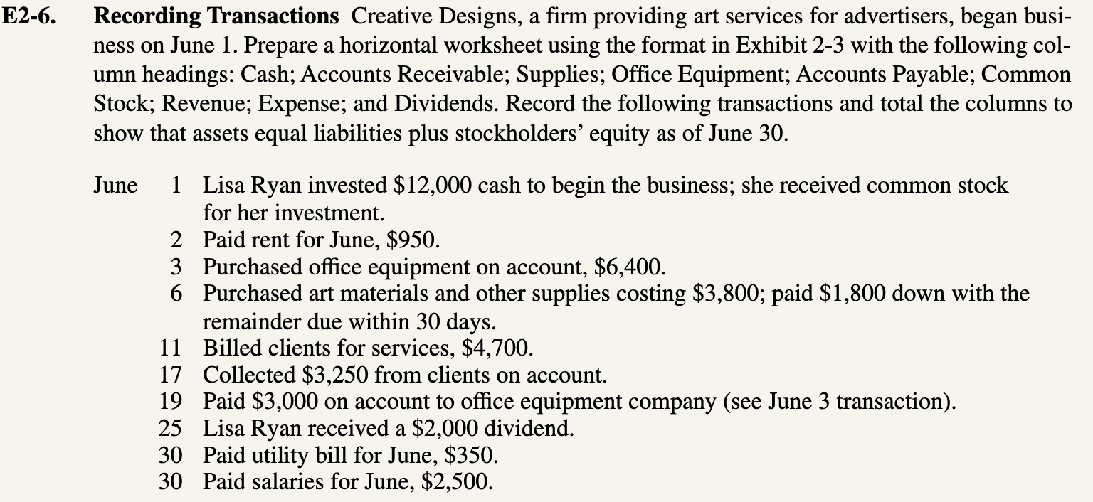
Chapter 2 e2-6

Slide 33
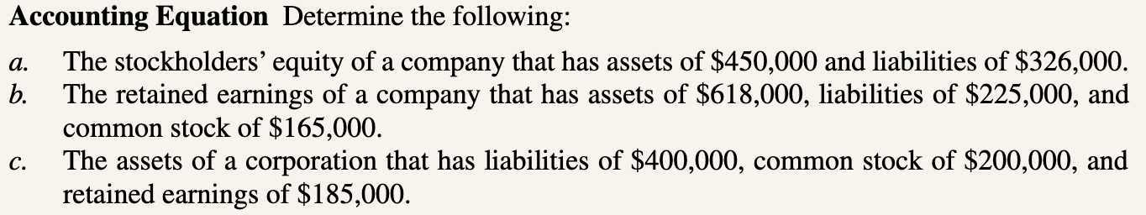
Chapter 2 P2-5

Slide 34
Chapter 3
Accrual accounting
Revenue recognition principle
Expense recognition principle
Quality of earnings
What is a trial balance
Debits & Credits – (multiple choice only)
Record transactions – financial statement effects (workout problem)
Must know balance sheet, income statement, and cash flow impact
Adjusting entries
Must know balance sheet, income statement, and cash flow impact
Closing entries – debit/credits (multiple choice only)
Notes:
Potentially 2-28
Potentially 2-34 or 2-35 (like in class example) --

Slide 35
Accrual Accounting
An accounting method where revenues/expenses are recorded when a transaction occurs
Requires adjustments to be made to reconcile current status of the balance sheet

Slide 36
revenue recognition principle
Recognize revenues for goods and services provided to customers at an amount expected to be received
This may be before the company actually receives the cash, i.e., when they bill a customer for a service or good, they recognize the income at that time
Must be at the time that, or after, the company satisfies the obligation by delivering the good(s) or service(s)
Revenue Related Accounts: Cash, Unearned Revenue, Accounts Recievable

Slide 37
expense recognition principle
Expenses shall be recognized when they are incurred
This may be before the expense is actually paid for (cash exchanges hands)
Expense Related Accounts: Prepaid Expense, Supplies, PPE, Accounts Payable (or any ___ Payable), Cash

Slide 38
Quality of Earnings
How well a company’s earnings report represents its underlying financial performance. Especially in regard to adjustments.
Good QOE: Adjustments accurately reflect the companies financial health
Conservative QOE: Adjustments are pessimistic, leading to lower net income + assets
Generally preferred by investors, since these will remain consistent YoY
Ways to measure QOE
Financial Statement Transaction Model
T-Accounts
Journal Entries

Slide 39
Adjusting Entries
Prepaid Expenses
Cash is paid before expenses are recognized
Insurance, rent
Unearned Revenues
Cash is received before the revenues area recognized
Girl Scout sold cookies and collected cash before she delivers them
Accrued Expenses
Cash is paid after the expense is recognized
Paying a Credit Card bill
Accrued Revenues
Cash is received after the revenue is recognized
You worked ten hours last week, but you will not be paid until next week

Slide 40
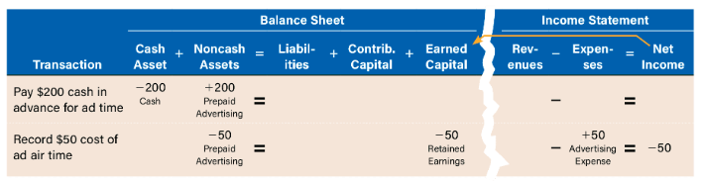
Prepaid expenses
Notes:
Example: insurance, rent
Pay cash before you expense
Creates an asset to use as you expense it in the future

Slide 41
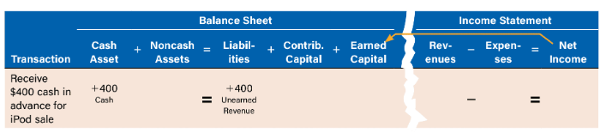
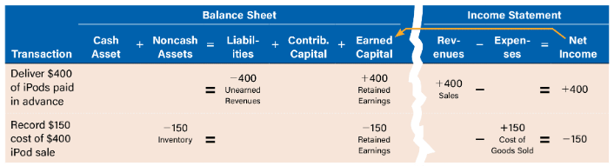
Unearned Revenues
Notes:
Collect revenue before selling the product
Creates a liability until you provide the product or service

Slide 42
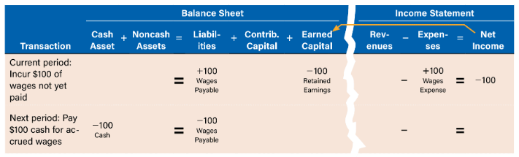
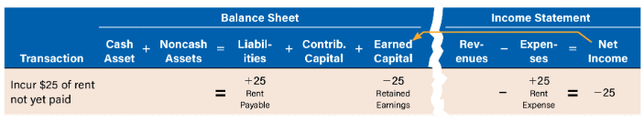
accrued expenses
Notes:
Paying bills on a credit card
You record the expense before paying the cash
Create a liability until you pay the cash

Slide 43
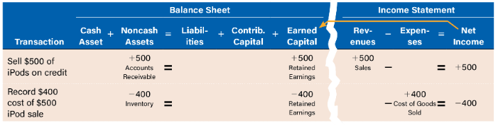
accrued revenues
Notes:
Selling items on credit
You have earned the revenue
Creates an asset (AR) until you collect the cash

Slide 44
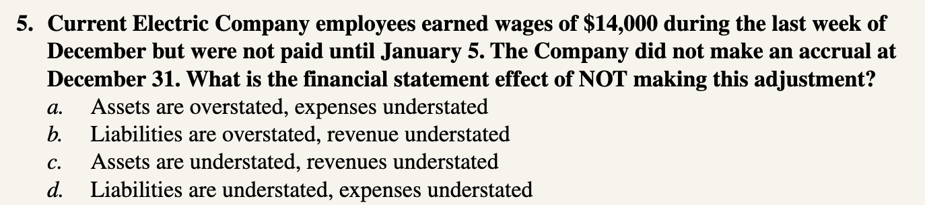
Chapter 3 Q3-5

Slide 45
Chapter 3 Se3-5

Slide 46
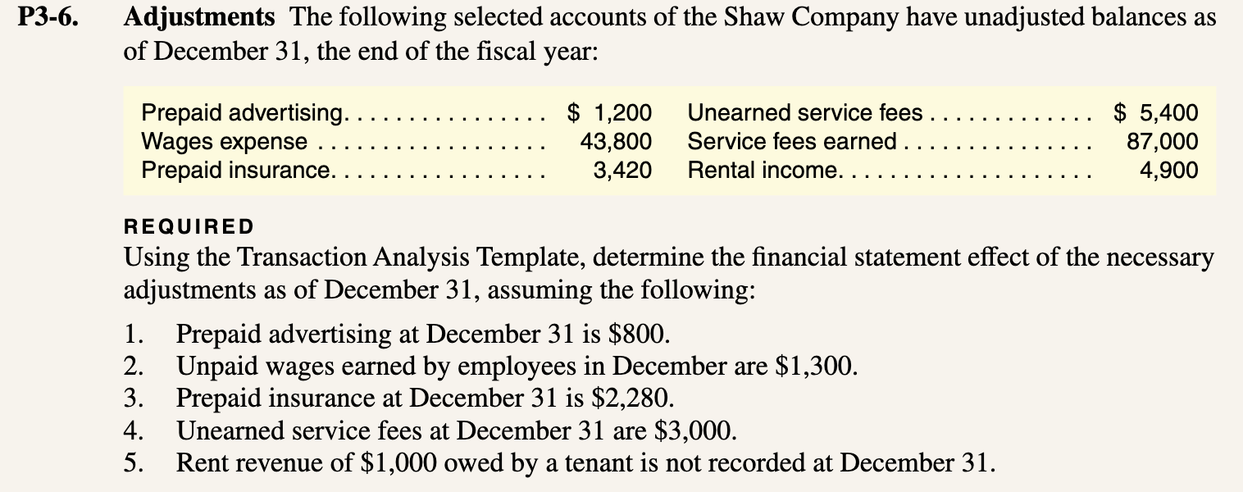
Chapter 3 P3-6

Slide 47

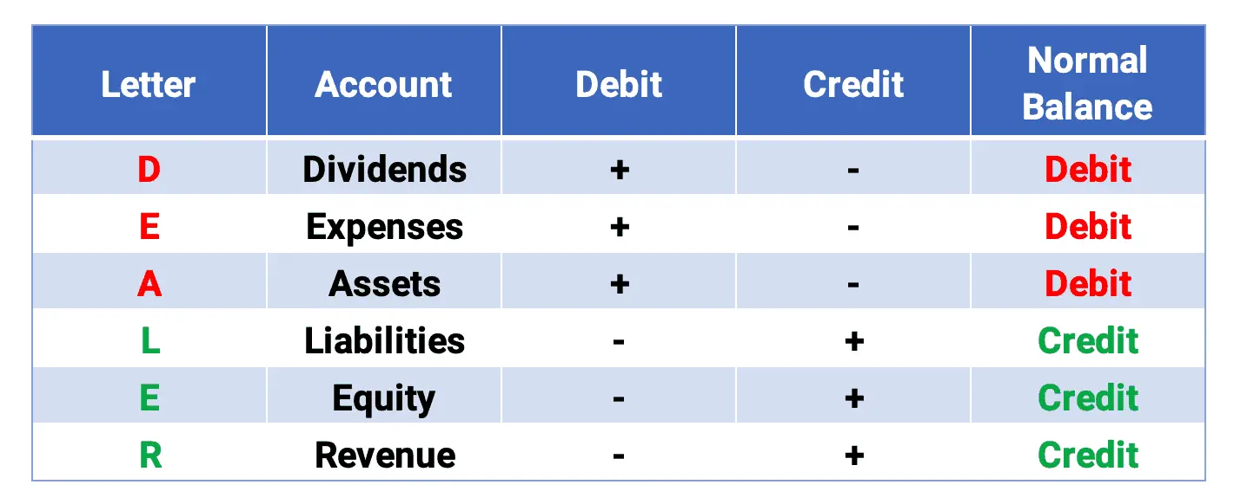
Debits and Credits
Dividends, Expenses, Assets
Debit = Increase
Credit = Decrease
Liabilities, Equity, Revenue
Debit = Decrease
Credit = Increase
Normal balance is side you increase on
Notes:
Revenues – debit decrease, credit increase
Expenses – debit increase, credit decrease
Dividends – debit increase, credit decrease

Slide 48
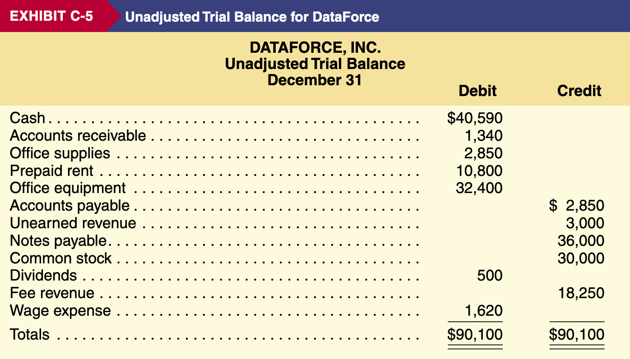
Trial balance
A listing of all general ledger accounts and their respective credits and debit balances
Prepared at the end of an accounting period after all transactions are recorded
amount of debits = amount of credits

Slide 49
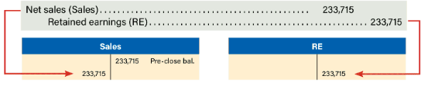
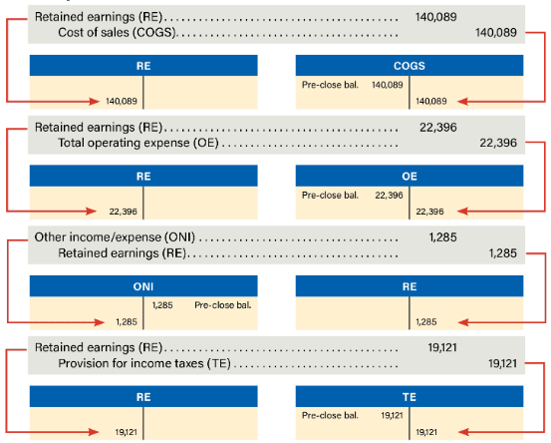
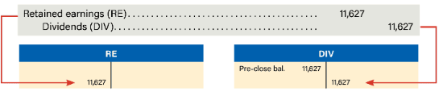
Closing Entries
**Close INCOME STATEMENT accounts (Sales/Revenue, COGS, expenses, dividends)
Move Net Sales to Retained Earnings
Move Money from Retained Earnings to cover losses and expenses
Move Money from retained earnings to cover dividends
Notes:
Retained earnings – debit decreases, credit increases (because it is an equity account)

Slide 50
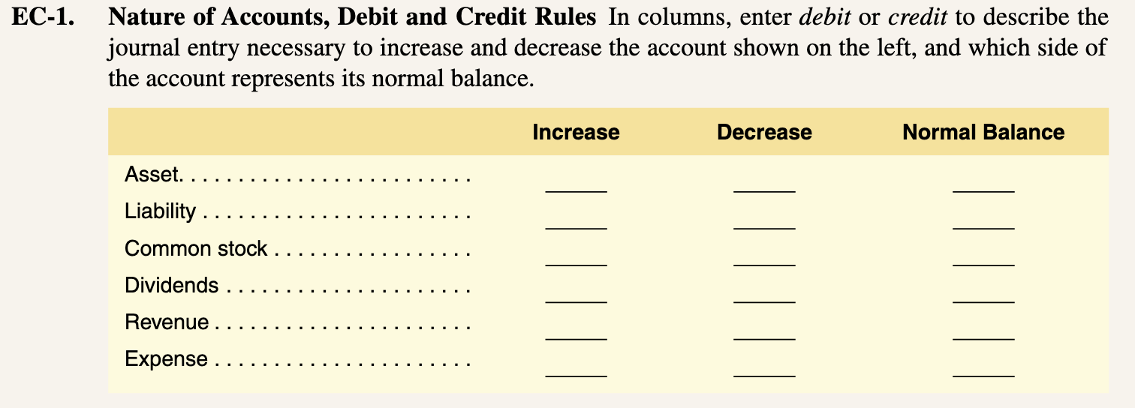
Appendix C Ec-1

Slide 51
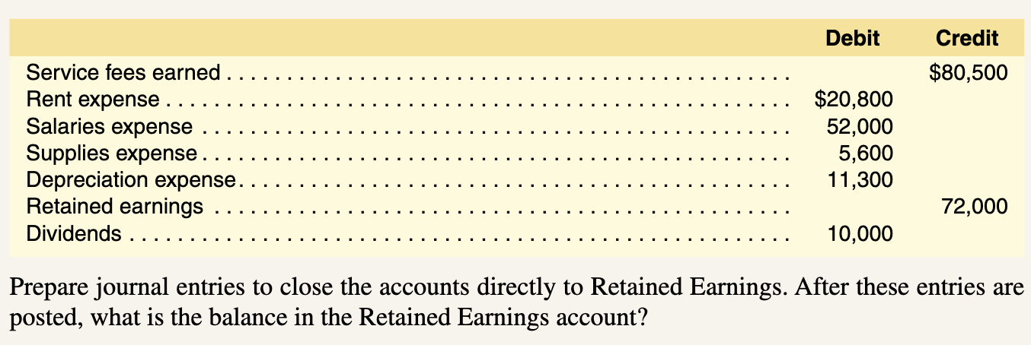
Appendix C Ec-3

Slide 52
Chapter 5
Fraud
Fraud triangle
Internal controls
COSO framework
Audit opinion related to internal controls
PCAOB
What is considered cash
Good cash controls
Bank reconciliations

Slide 53
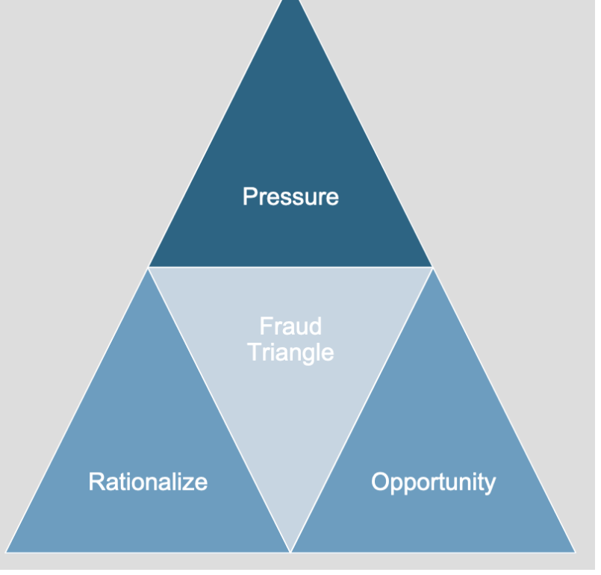
Fraud + Fraud Triangle
Fraud – Intentionally misreporting a company’s financial statements for personal or corporate gain
Notes:
Fraud triangle is the visual representation of why fraud can occur, including some of the most common factors for fraud

Slide 54
Internal Controls
Internal Controls – Management’s responsibility to prevent errors + deter fraud by:
Safeguarding assets, providing accurate information, promoting efficiency, enforcing policies, and complying with regulations
Types of Internal Controls:
Preventative Controls: Stopping problems before they happen (ex. Payment Authorization)
Detective Controls: Finds problems after they happen (ex. Bank Adjustments
Audit Opinion’s for Internal Controls – Since SOX Act, companies must report on design/effectiveness of their internal control. Accounting firms also give audit opinions on the design/effectiveness of internal controls
Public Company Accounting Oversight Board – Issues auditing standards, oversees quality controls on public accounting firms

Slide 55
Coso Framework
Control Environment – setting the tone of the organization to be ethical
Risk Assessment – identifying and analyzing risks that face the organization
Control Activities – the specific policies designed to reduce risk (internal controls)
Information and Communication – making sure management and employees are on same page
Monitoring Activities – assessing internal system, evaluating its effectiveness

Slide 56
Cash + Good Cash Controls
Cash - Checks, Currency, Money account orders, Checking account balance, Saving account balance
Cash Equivalent – Highly Liquid assets, Short term investments (<90 days), Risk free securities
Good Cash Controls: Clear policies, separation of duties, bank reconciliation
Receipts: Record at bank when received, Deposit at bank daily, Count cash frequently, Give customers receipts
Disbursements: Pay with checks (prenumbered), Segregate duties, Require signatures and documentation on larger amounts

Slide 57
Bank reconciliation
Reconciling the book balances with the bank balances
Terms:
Bank statement debit memos
-Reduce customers account balance
-Bank Fee
Bank statement credit memos
Increase customers account balance
- Interest earned
Outstanding checks
- Checks written by company, not yet received by bank
Deposits in Transit
-Deposits not yet recorded by bank

Slide 58
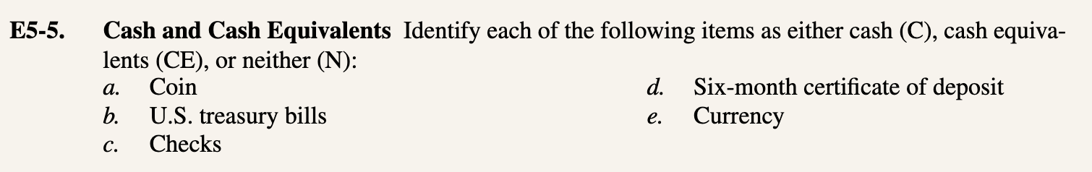
Chapter 5 e5-5

Slide 59
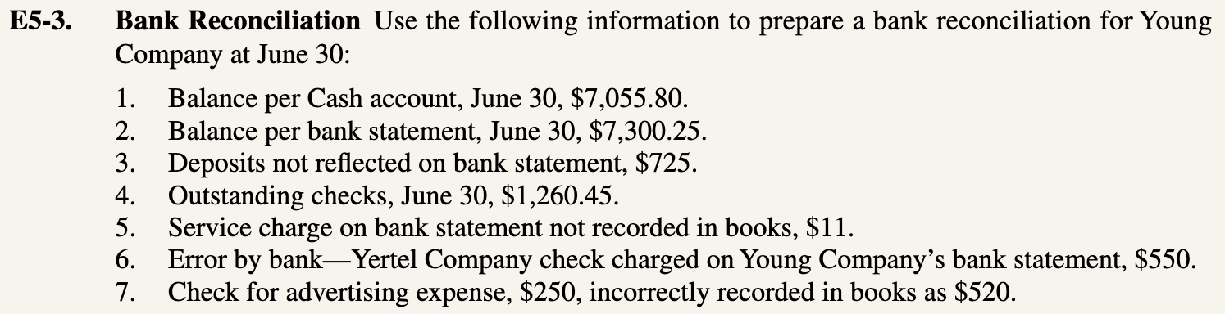
Chapter 5 E5-3

Slide 60
Chapter 11
Vertical analysis
Horizontal analysis
Financial ratios
Liquidity
Solvency
Profitability
Interest in Ratios
Cash conversion cycle

Slide 61
vertical versus horizontal analysis
Vertical Analysis
Expresses financial statements in ratio form
Income in terms of percent of net sales, balance sheet in terms of percent of total assets
AKA Common Size Financial Statements
Useful to comparing companies of different sizes
Horizontal Analysis
Expresses changes in financial statements across time
Allows for the identification of trends within a company
Used to compare a company to itself during different accounting cycles

Slide 62
liquidity
Liquidity refers to cash availability; How much a company has and how quickly it can be accessed/raised on short notice
Current Ratio
Liquidity based on Current Assets and Current Liabilities
Quick Ratio
Liquidity based on Cash, Marketable Securities, Accounts Receivable; Only the most liquid current assets

Slide 63
solvency
Solvency refers to a company’s ability to meet its debt obligations (interest payments and loan repayments)
Liabilities-To-Equity
Tells how reliant a company is on its creditor financing (loans) compared to equity (stock investors)
Interest Coverage Ratio
Core profits to liabilities, meet debt obligation based on income

Slide 64
profitability versus efficiency
Profitability:
Assessed by looking at Profit Margin
How profitable is each dollar that is being spent?
Ex: Gross profit margin/operating expense margin/profit margin
Efficiency/Productivity:
Assessed by looking at Asset Turnover
How productive are a company’s assets in generating sales?
Ex: Cash conversion cycle/PPE turnover

Slide 65
Cash Conversion Cycle
Number of Days the company has its cash tied up in receivable and inventories less the number of days of trade credit provided by company suppliers
Average Days in Sales Outstanding
+Average Days in Inventory Outstanding
-Average Days Payable Outstanding
=Average Cash Conversion Cycle
Notes:
Want low Days in Sales Outstanding
Want low Days in Inventory Outstanding
Want high Days Payable

Slide 66
Interest in Ratios + CCC
Ratios are useful to both internal and external users, as a quantifying measure of a company’s performance in a specific category
Ex. Short term lenders would be interested in a company's liquidity ratios, long term lenders would be interested in a company’s solvency ratios
Cash Conversion Cycle measures how fast companies turn investments in inventory into cash
Negative CCC means you are selling goods before paying supplier
Long CCC (>60 days) means you are converting inventory to cash slowly
Smaller CCC indicates business efficiency, converting inventory to cash fast

Slide 67
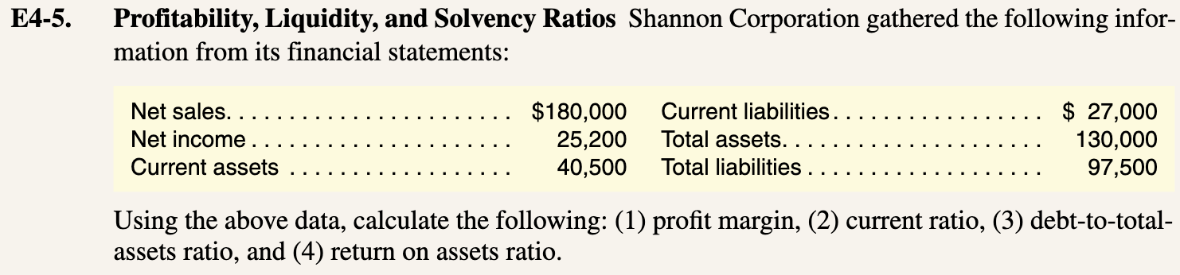
Chapter 4 E4-5

Slide 68
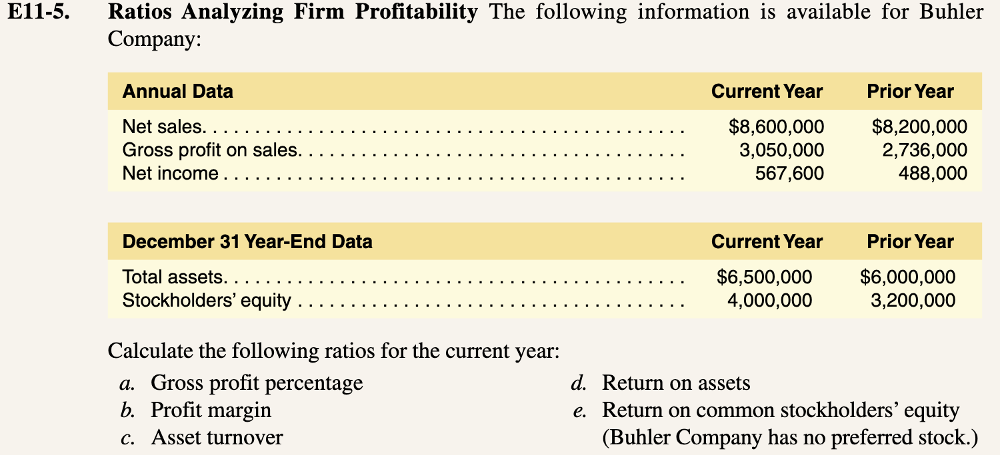
Chapter 11 E11-5

Slide 69
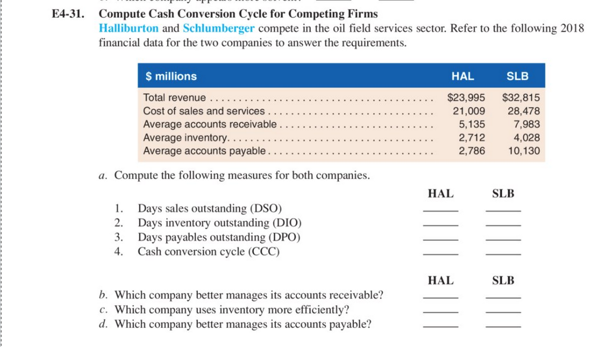
CCC Problem from last year!

